Slide 1
Introduction to R

Slide 2
Access to R
Install on your computer
Go to http://cran.us.r-project.org/

Slide 3
R as a Basic Calculator
(2+3)/5 # everything after the pound sign is ignored
(2+ 3) / 5 # Spaces are ignored.
(2+3)/ # If your submitted input is not complete then a plus sign
appears on the next line. You can then complete the
input. If you would rather start over press the Escape
key.
3*2 # 3 times 2
3^2 # 3 to the power 2

Slide 4
R as a Basic Calculator
3^.5 # 3 to the power 0.5 which is the same as the
square root of 3
sqrt(3) # square root of 3
log(10) # natural log of 10
exp(log(10)) # exponential of the natural log of 10
Note: R is CASE SENSITIVE.

Slide 5
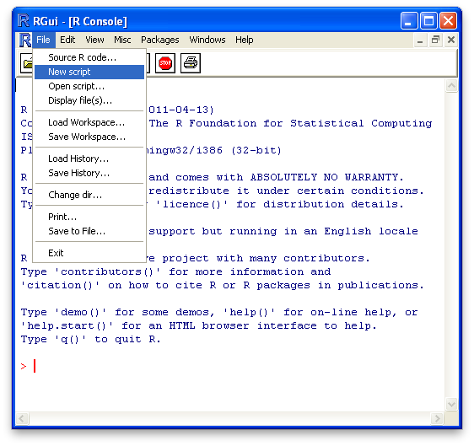
Using a Text Editor

Slide 6
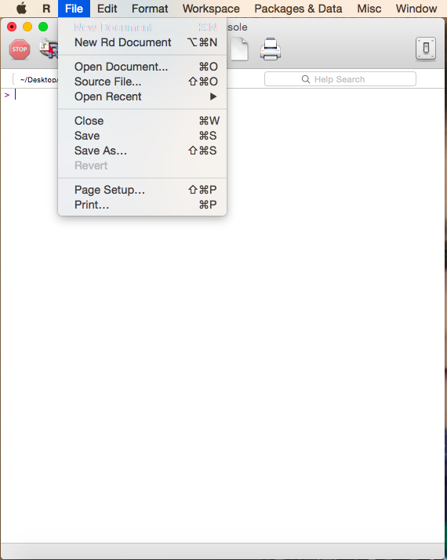
Using a Text Editor

Slide 7
Data Analysis in Two Steps
enter data
process data
x = c(55,58,60,62,63,64,65,66,68,72,72,72,83,83,95)
mean(x)

Slide 8
Examples of Data Processing
median(x) # calculates the median of x
sd(x) # calculates the standard deviation of x
sort(x) # sorts x
min(x) # finds the minimum of x
max(x) # finds the maximum of x
fivenum(x) # returns the five-number summary of x
IQR(x) # calculates the interquartile range of x
hist(x) # produces a frequency histogram of x
boxplot(x) # produces a boxplot of x

Slide 9
R Functions
To get more information on R functions type question mark followed by the name of the function.
For example,
?mean
?sd

Slide 10
Entering Data into R
Consider the file class.csv
Save this file to your Desktop; right-click on the link and select “Save as” and then select the type “All Files”.

Slide 11
Entering Data into R
class = read.csv('class.csv')
The function read.csv() reads the data contained in the file and puts it into a structure called a data frame.
attach(class)
The function attach() makes it possible to refer to the variables in the data frame by their names.
mean(final)

Slide 12
QUESTIONS?

